Slide 1
Chapter 6.4
Factoring trinomials

Slide 2
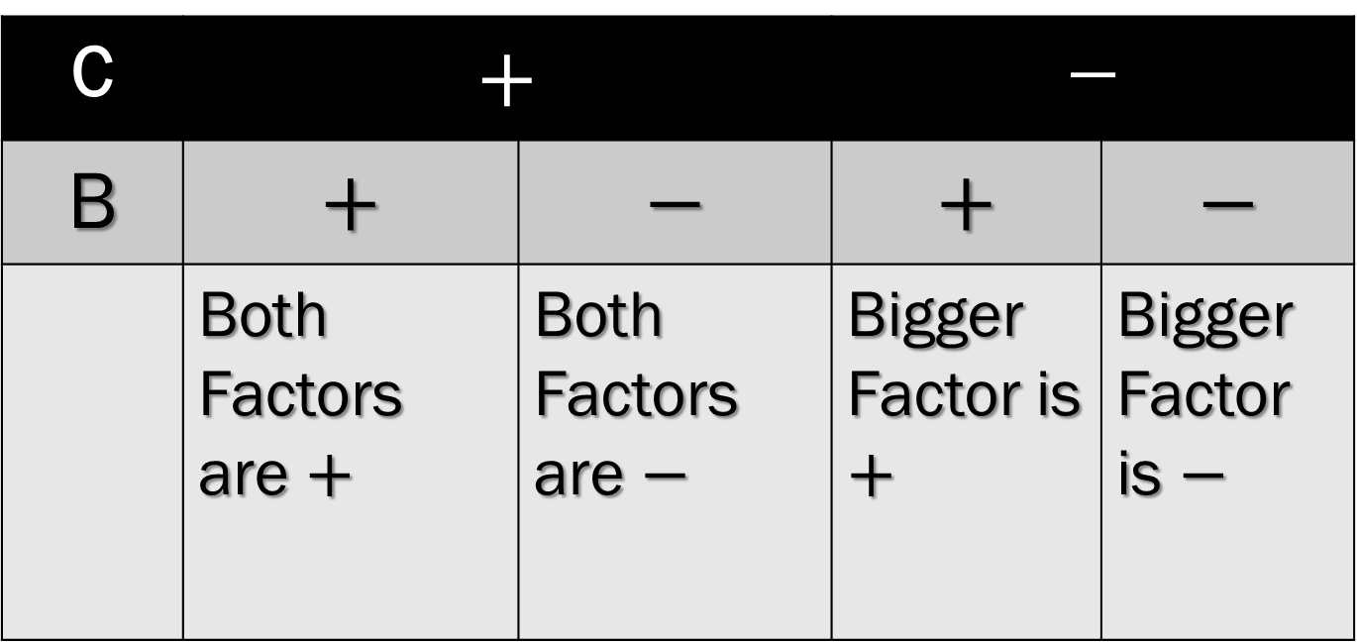
SIGN CHART
C | $$+$$ |  | $$−$$
B | $$+$$ | $$−$$ | $$+$$ | $$−$$
 | Both Factors are $+$ | Both Factors are $−$ | Bigger Factor is $+$ | Bigger Factor is $−$

Slide 3

SHORT CUT
$${Ax}^{2}+Bx+C$$
Write two sets of parenthesis,
( )( ). These will be the factors of the trinomial.
2. Think of factors of c that add up to b. (Use Chart for Signs)

Slide 4
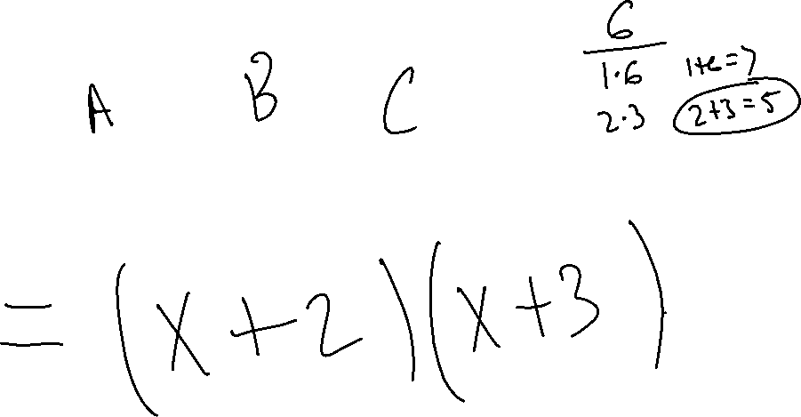
Example 1

Slide 5
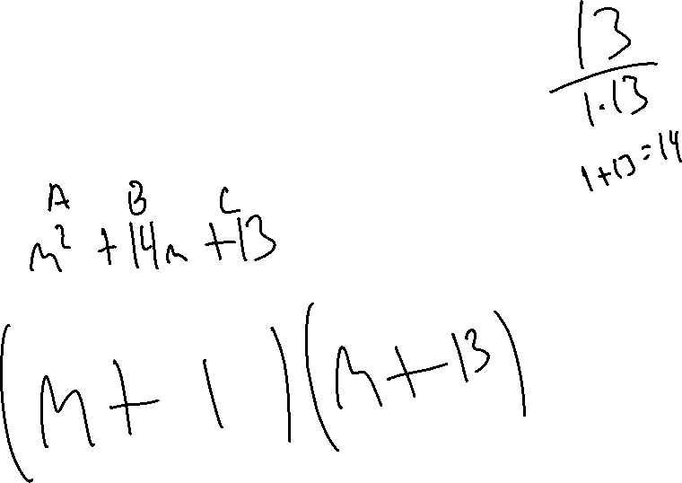
Example 2

Slide 6
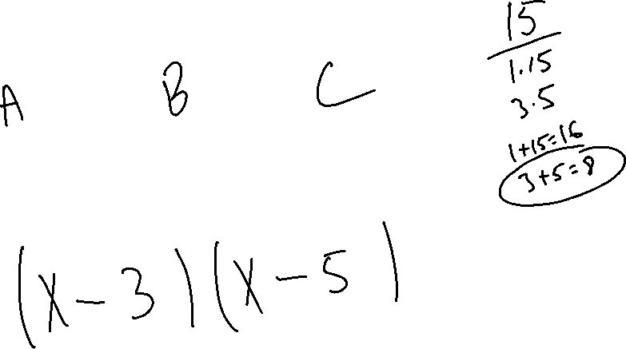
Example 3

Slide 7
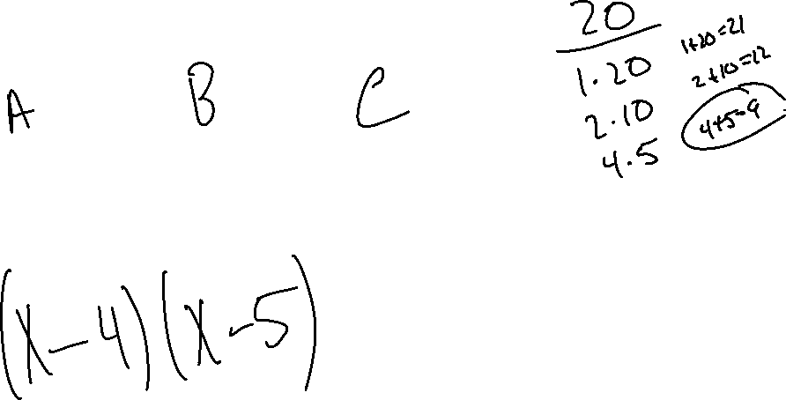
Example 4

Slide 8
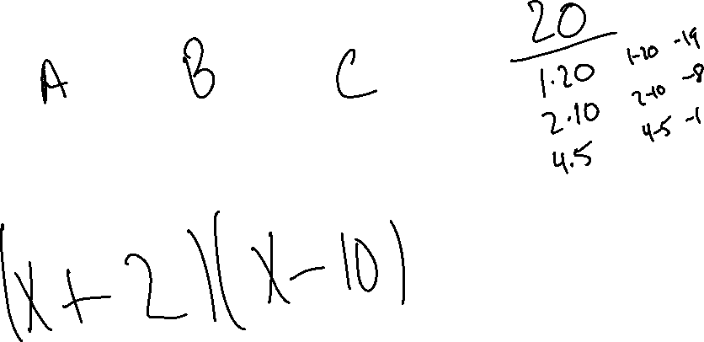
Example 5

Slide 9
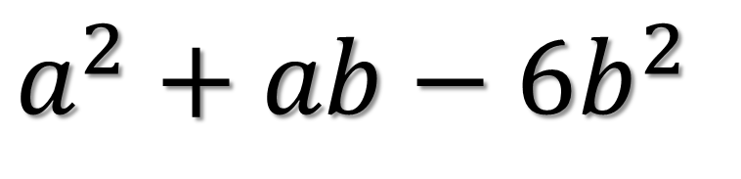
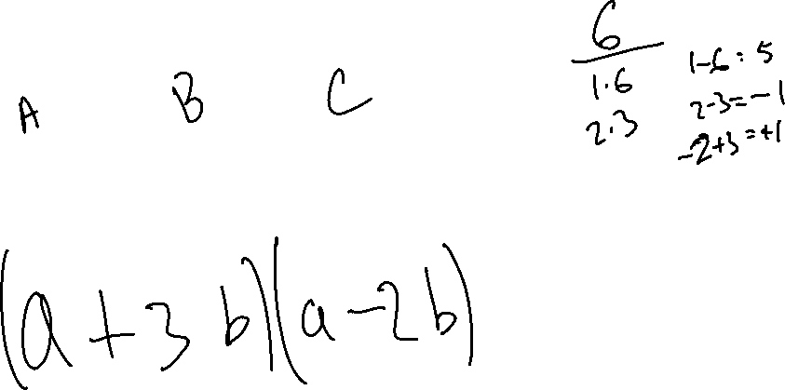
Example 6
$$a^{2}+ab−{6b}^{2}$$

